Slide 1
FAke news Classification
By:-
Tirth Patel
Dipen Patel

Slide 2

About Fake News problem
Currently we see a lot of problems faced due to fake news.
Allegedly the Elections 2016 were influenced by fake news.
Also, in recent developments we see fake video of Ex-President Barack Obama, where researchers from University of Washington trained a model on 14 hours of videos of Ex-President Obama's interviews and used it to match the voice with a synthetic figure.
Although this was developed as a technology this can have bad impacts like generation of hate speech.

Slide 3
So what to do?
How do we distinguish real news from fake news?
There are many ways to verify the source, some are physical like calling multiple news stations and confirming the news.
Or we can use past data of fake vs not fake news from multiple news stations or multiple authors and verify if the information is valid or not.
Use Machine Learning to predict if the news article is fake or not.

Slide 4
AIM of the project
To classify the news whether it is fake or not.
We would need a lot of data to train the algorithm on.
Run Machine Learning algorithms on the dataset and compare the results of the models of Machine Learning.
We compare the Machine Learning algorithms by varying the parameters of the model and seeing the result on the testing set.

Slide 5
Dataset
We used dataset from a Kaggle challenge having following specifications for training and testing data. As shown in the figure
The dataset consists of about 25k data and with a lot of inconsistencies and problems.
So we would clean the data using various Natural Language Processing techniques to get proper data.
Training Dataset
Testing Dataset

Slide 6
Problem
Classify a set of news into two classes {Fake, Not Fake}
Y = {Fake, Not Fake}
Features would be set TFIDF vector of n-gram words.
Function would be the classifiers that would classify the vector into their class.

Slide 7
Data cleaning tasks
Starting with a problem of cleaning a data which contains words. The whole dataset us based on words.
So Natural Language Processing methods would be required to clean the data.
First, we convert the data into lower case and then remove unnecessary data like punctuations, conjugations, articles and other such words.
Also, some data is missing, or the data contains NAN, which was replaced with a null string so that the data doesn't impact the final words list.
The words are then converted to tokens. The tokenized words are then converted to Term Frequency Inverse Document Frequency table.
We then convert the table into a set of vectors and here we take the n-grams approach. Here we take one to two words in the vector.

Slide 8
DAta splitting
Training set split into 70% training and 30% cross-validation.
Testing Dataset

Slide 9
Classifiers
Once we create the vectors, we use them as input to classifiers.
Here we use following classifiers for the task:
Naïve Bayes
K-Nearest Neighbor
Logistic Regressor
Random Forest

Slide 10
Naïve Bayes
We use the basic Bayesian Classifier to classify the news samples having two class classifier.
The performance of the algorithm is as given in the table.
For computation we had about 20000*(number of single words + number of 2-gram words) combined to form a TFIDF vector and a count vector in turn. All these data is passed in traning.
And about 5000*(number of single words + number of 2-gram words)
Alpha Value | Cross Validation accuracy | Test accuracy
1 | 0.78 | 0.79
0.1 | 0.89 | 0.91
0.01 | 0.93 | 0.95
0.001 | 0.93 | 0.95

Slide 11
Logistic Regression
We applied a Logistic Regression model which we learnt in the class for seeing the practical implications of the same. We applied following two solvers for it:
Stochastic Gradient Descent
SAG (Stochastic Gradient Averaging)
SAGA (A variant of Stochastic Gradient Averaging(SAG))
With Logistic Regression model, we tried using following parameters:
With L2 Regularization function.
Solver | Accuracy
SGD | 93%
SAG | 93.5%
SAGA | 97%

Slide 12
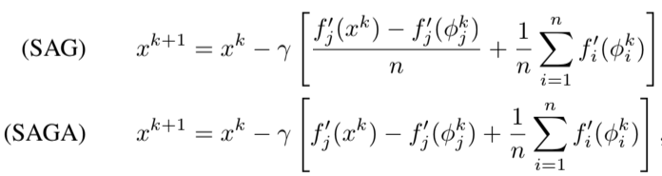
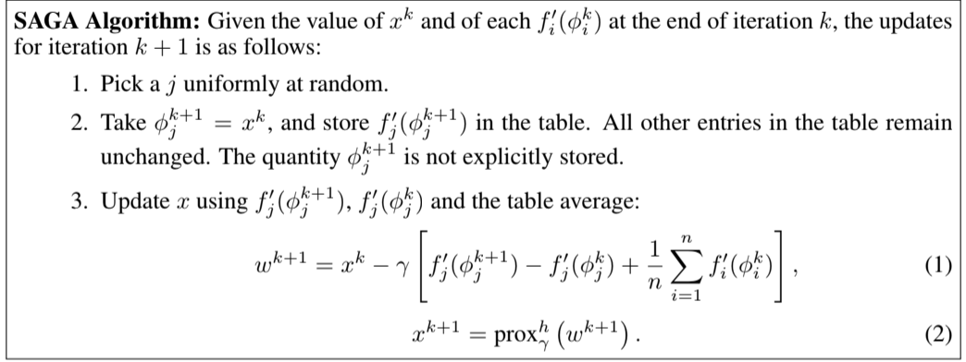
Solvers

Slide 13
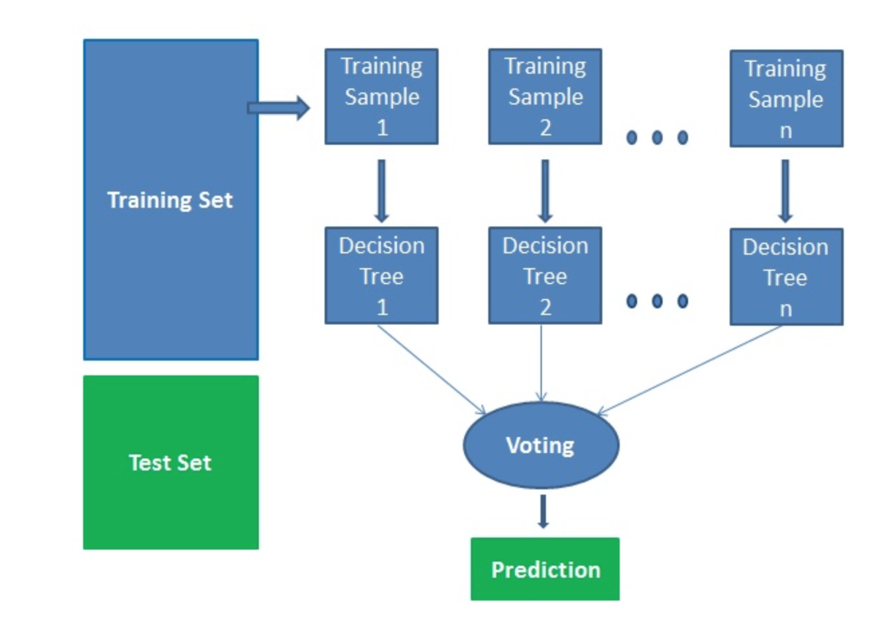
Random Forest
This is an Ensemble Classifier.
Ensemble classifiers are basically a two or more classifiers put together to improve the accuracy.
Decision trees have a habit of overfitting to their data, which means they do not generalize well to new data.
Random Forest solves this problem by growing multiple decision trees based on numerous samples of data and then averages those predictions to find the correct prediction.

Slide 14
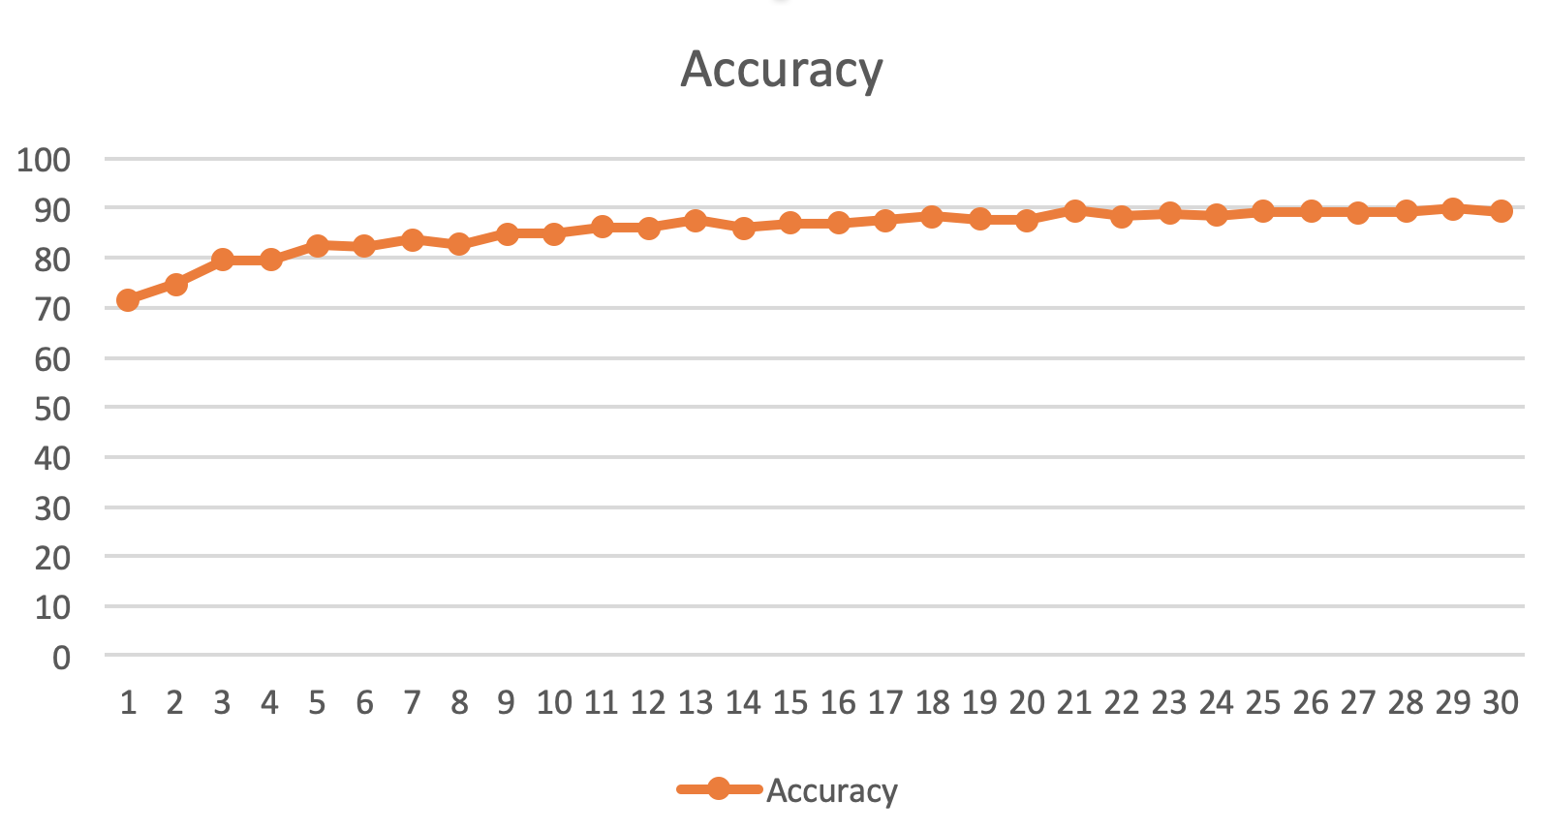
Results with Random Forest
Accuracy vs Number of trees graph

Slide 15
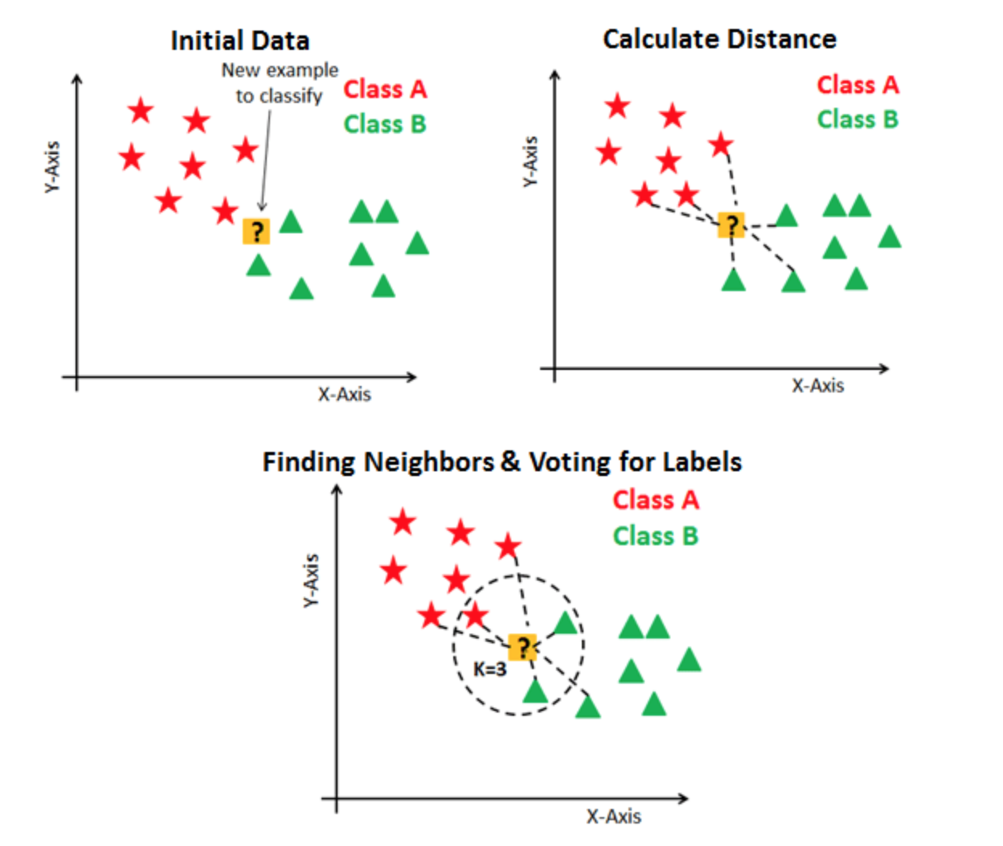
K-Nearest Neighbor
In KNN, K is the number of nearest neighbors. The number of neighbors is the core deciding factor. K is generally an odd number if the number of classes is 2.
KNN performs better with a lower number of features than a large number of features.
You can say that when the number of features increases than it requires more data.
Increase in dimension also leads to the problem of overfitting.
To avoid overfitting, the needed data will need to grow exponentially as you increase the number of dimensions.
This problem of higher dimension is known as the Curse of Dimensionality.
Neighbors | Accuracy
3 | 75%
5 | 77.3%
7 | 79%
9 | 79.1%

Slide 16
Future directions
For further implementation of the classifier, we would like to use LSTM classifier using Recurrent Neural Network.
For which, need a bit of higher resources to train our model.
Create visualizations from the data we obtained.

Slide 17
Libraries or tools used
Pandas for creation of matrix of TFIDF and Vector
NLTK for TFIDF vector generations and count vector generation.
Sci-kit Learn library for mostly all classifiers.
Dataset from a Kaggle challenge.

Slide 18
Conclusion
So, from the comparison of the models used, we see that Logistic Regression perform better in an overall perspective.
However, Naïve Bayes, Random Forest also give similar results.
KNN doesn't give much better performance for the task.

Slide 19
Sources
https://www.datacamp.com/community/tutorials/random-forests-classifier-python
https://www.youtube.com/watch?v=UCwbJxW-ZRg
https://arxiv.org/abs/1407.0202
https://www.datacamp.com/community/tutorials/k-nearest-neighbor-classification-scikit-learn
https://www.kaggle.com/c/fake-news/data

Slide 20
Thank you

